Slide 1
Designing Packages, Symbols, and Devices

Slide 2
PCM Assembly
https://youtu.be/gu0v8lfLcKg?t=3m59s
https://youtu.be/2qk5vxWY46A?t=2m28s

Slide 3
PCB Libraries
To use a part on a PCB, you need a library entry for it
Physical/mechanical information for the board
Logical/electrical information for the schematic
Mapping between the two
Metadata
A well designed library, will make your life much, much easier.
There are lots of libraries are the internet
Some are good, some are bad, some a poor match for what we need.

Slide 4
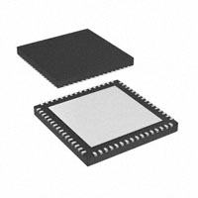
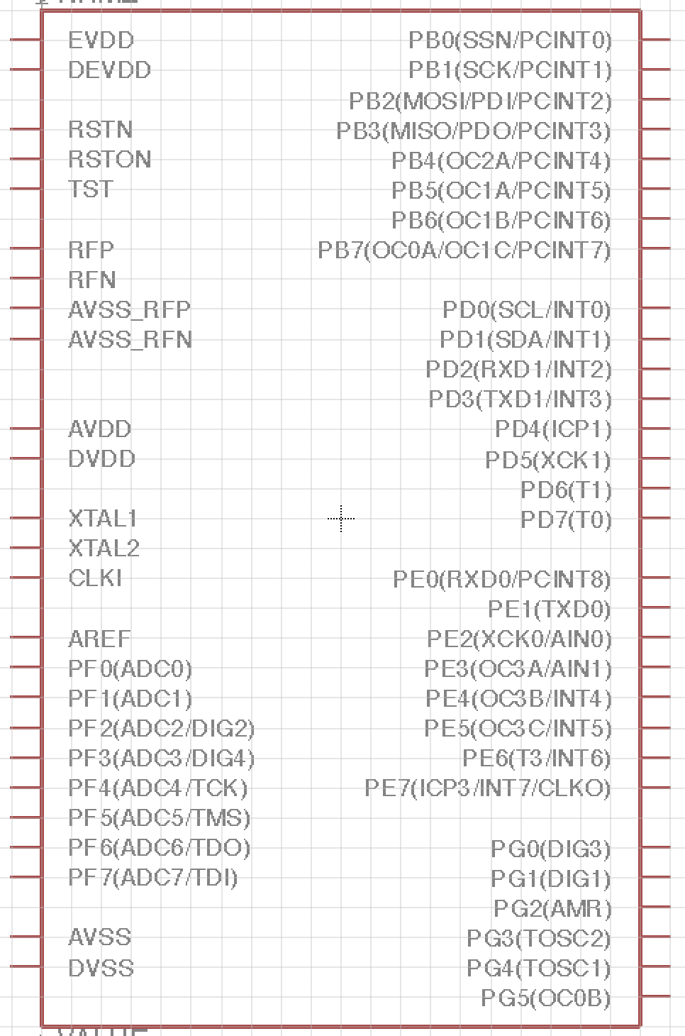
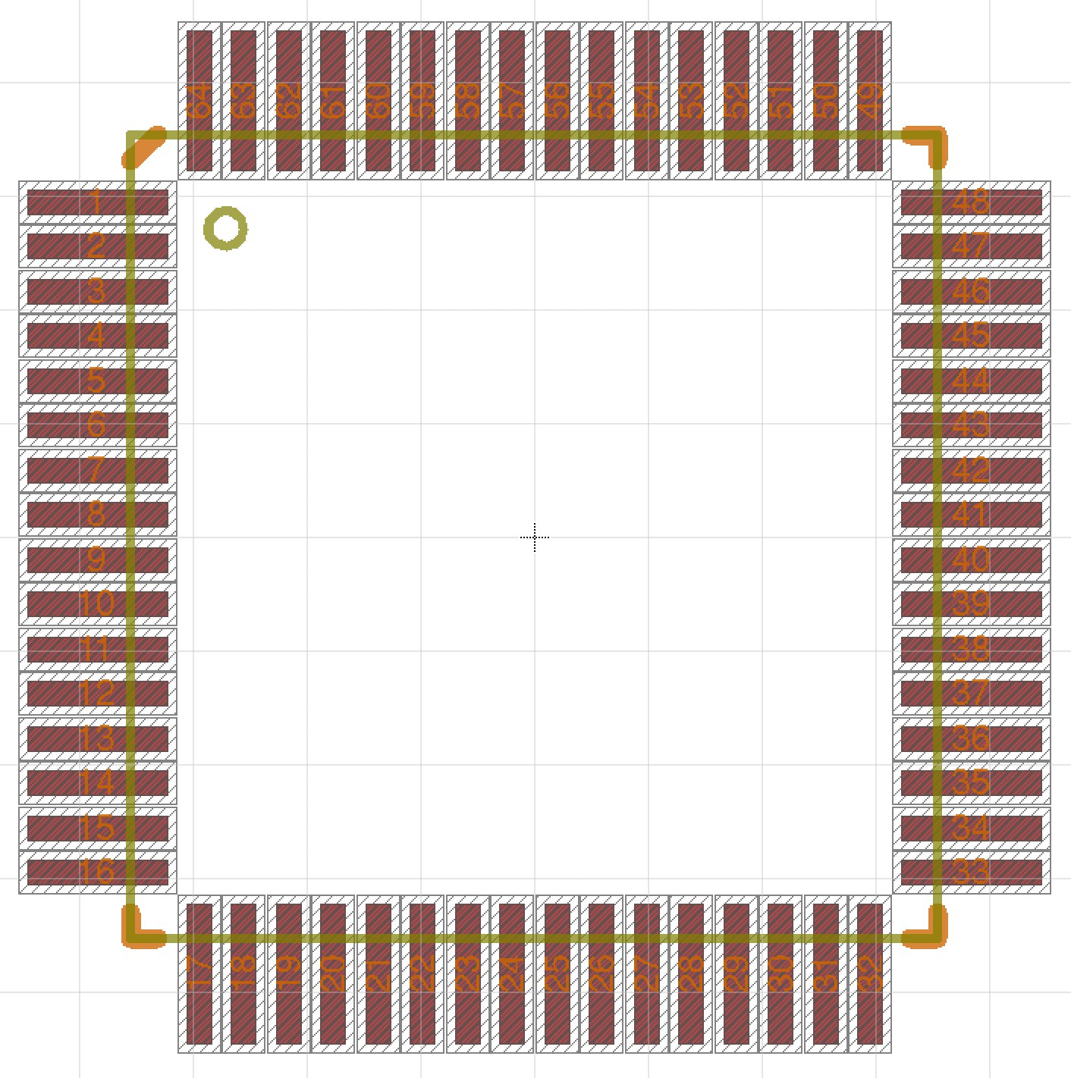
Physical part
Package
Device Pin Mapping
Symbol

Slide 5
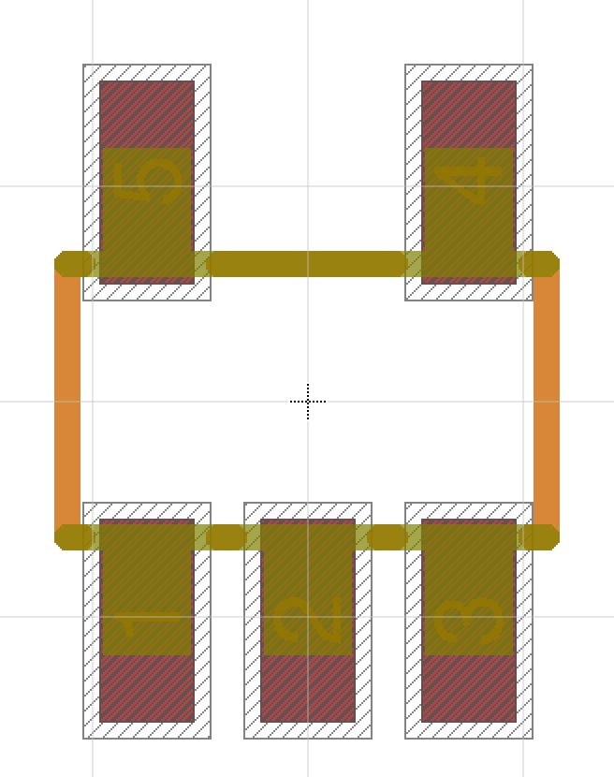
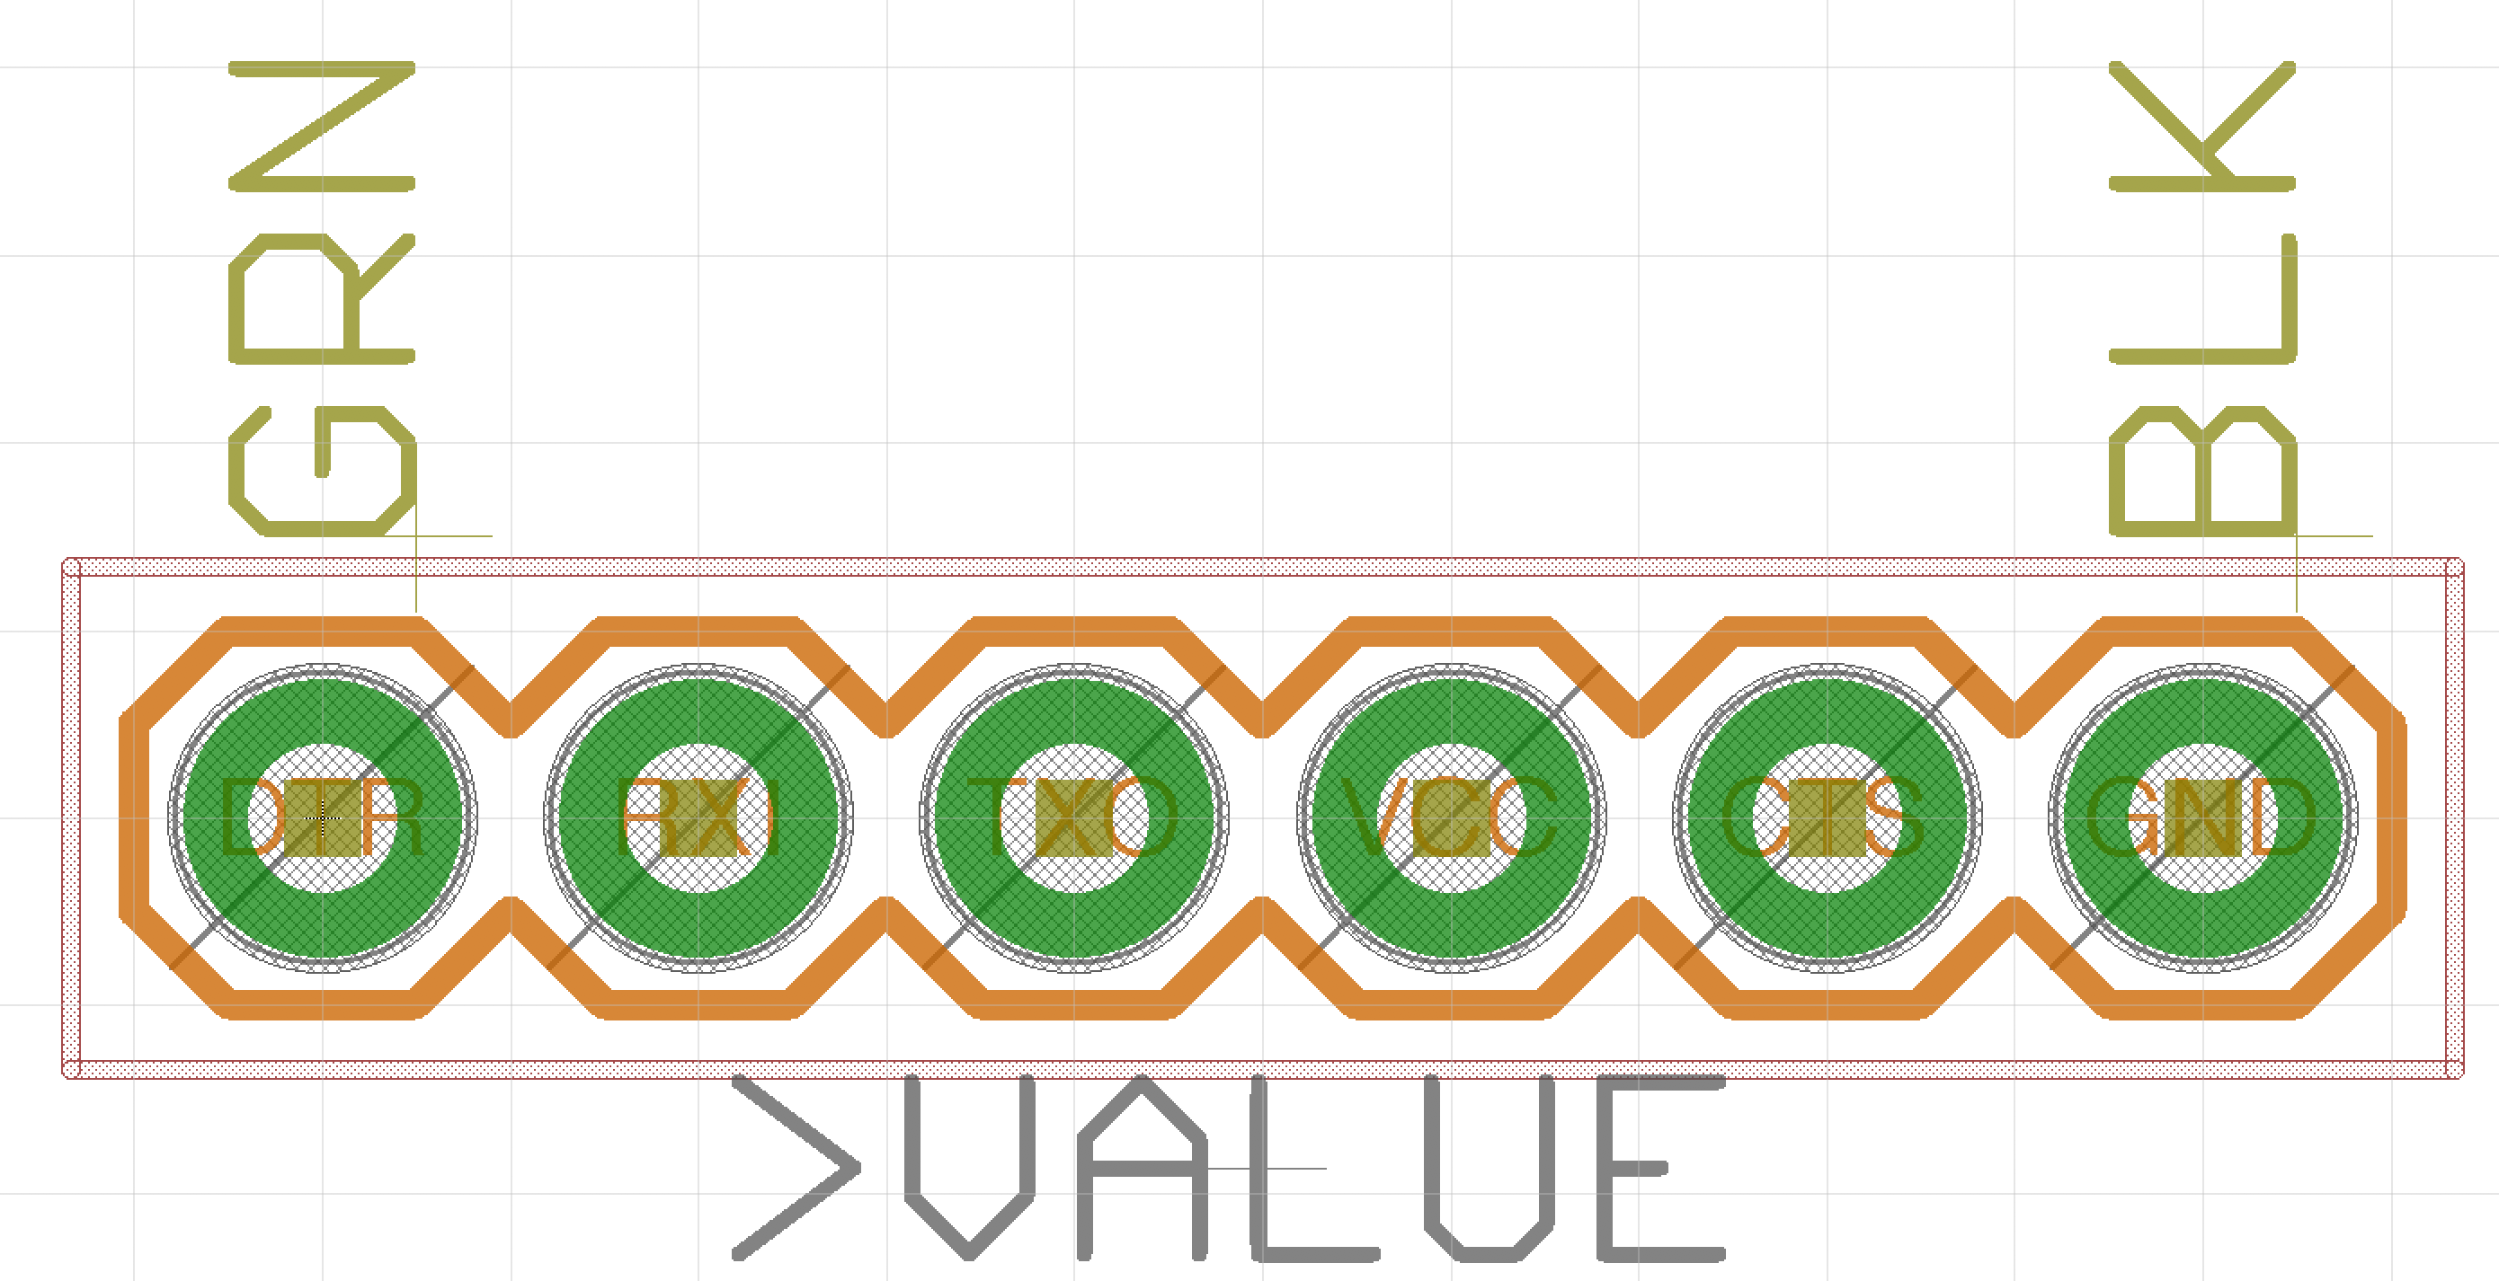
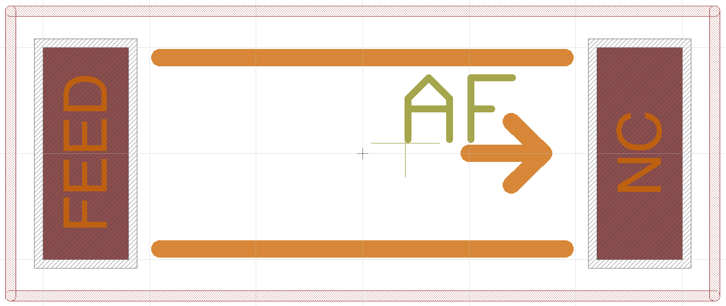
PCB Libraries: Packages
Mechanical description of the part
Electrical connections (i.e., pads and SMDs)
Other things: “keepouts”, mounting holes, documentation, labels etc.
Generic packages: e.g., 0805 Resistor
Specific packages: e.g., Atmegat128RF

Slide 6
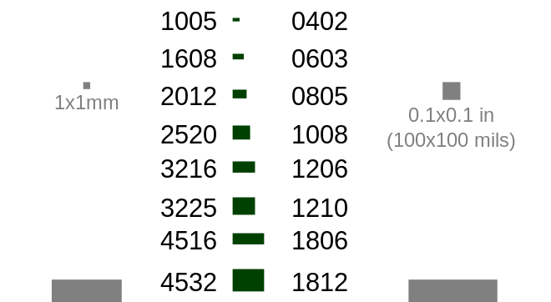
Part Sizes

Slide 7
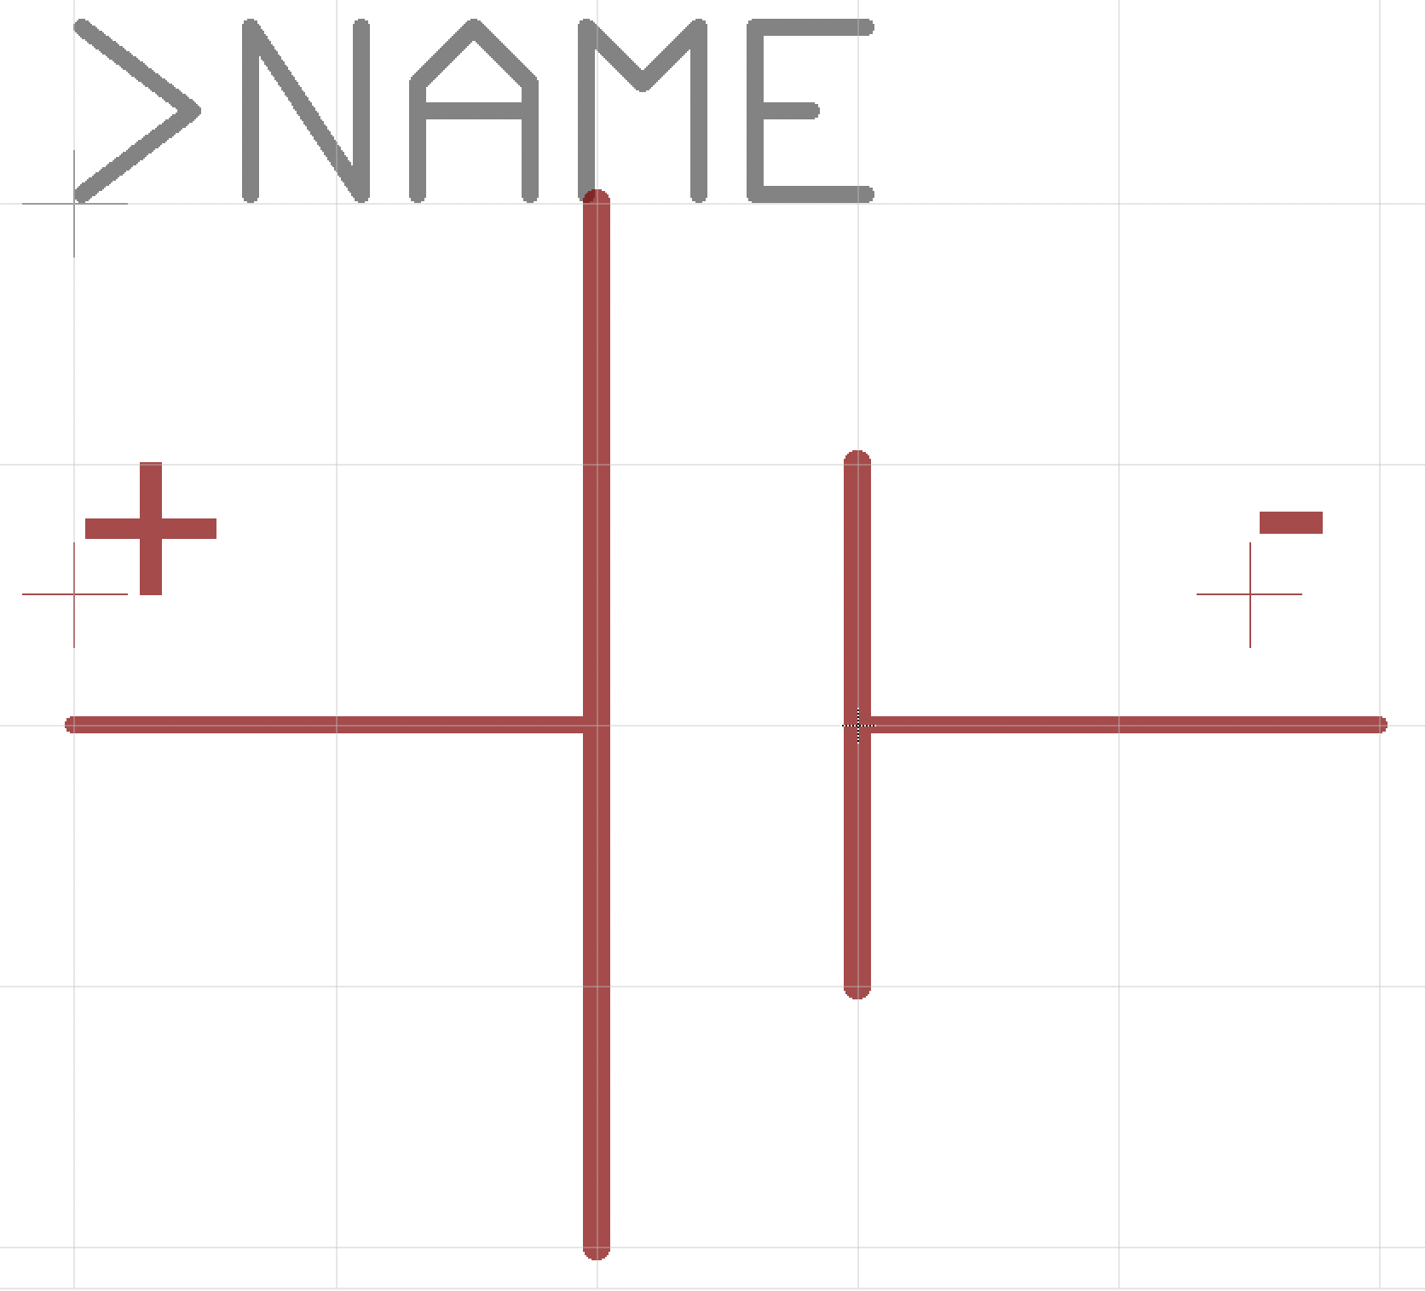
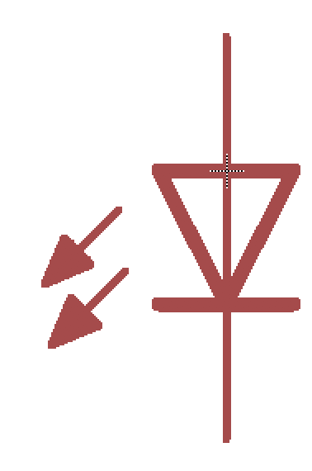
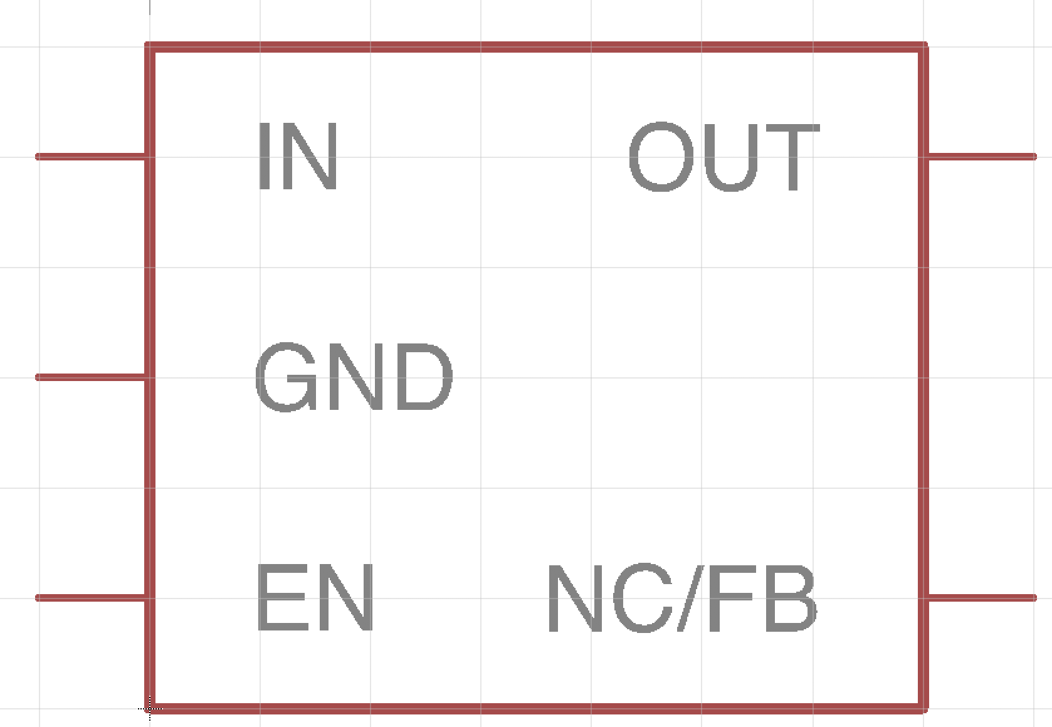
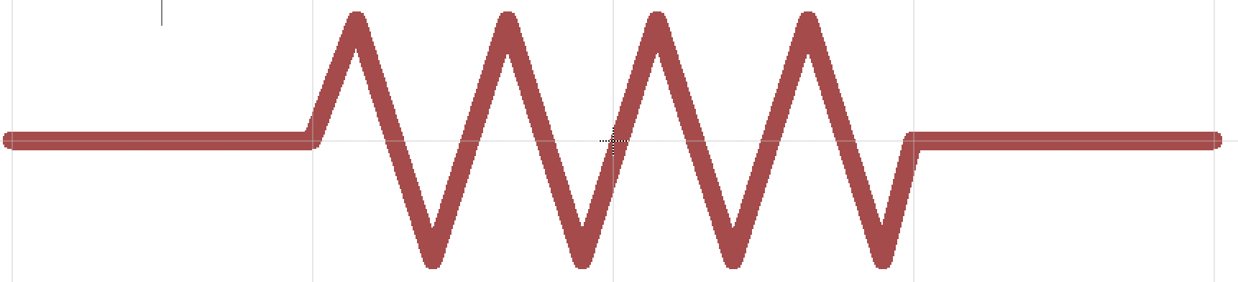
PCB Libraries: Symbols
Schematic representation of the component
Electrical connection points – “pins”
Generic symbols: resistors, capacitors, etc.
Specific symbols: e.g., Atmega128RF
Documentation, labels, etc.
Organized for ease of use and readability

Slide 8
PCB Libraries: Devices
Devices map between
1 symbol
>= 1 packages
For each package, the device maps the schematic pins to the package pads/SMDs.
Metadata
“attributes” -- E.g., Manufacturer, part number, etc.
Name prefix for reference designators -- e.g, the “R” in R1, R2, etc.
Does it have a “value” (e.g., a resistor’s value is it’s resistance, but a microcontroller doesn’t have a value)

Slide 9
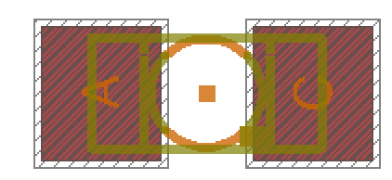
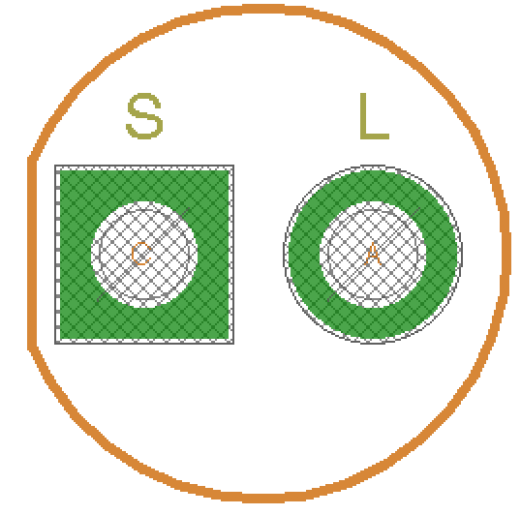
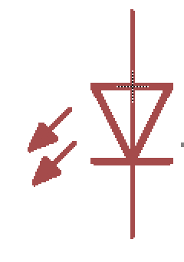


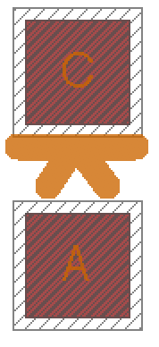
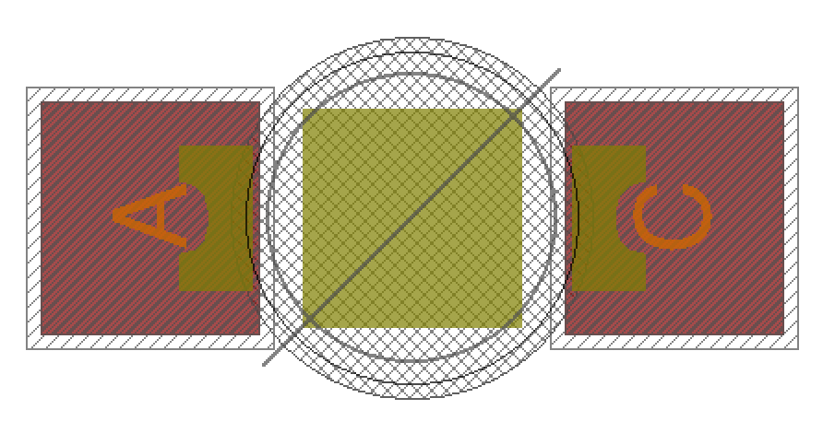
Device Example: LED
One Symbol
Many Packages

Slide 10
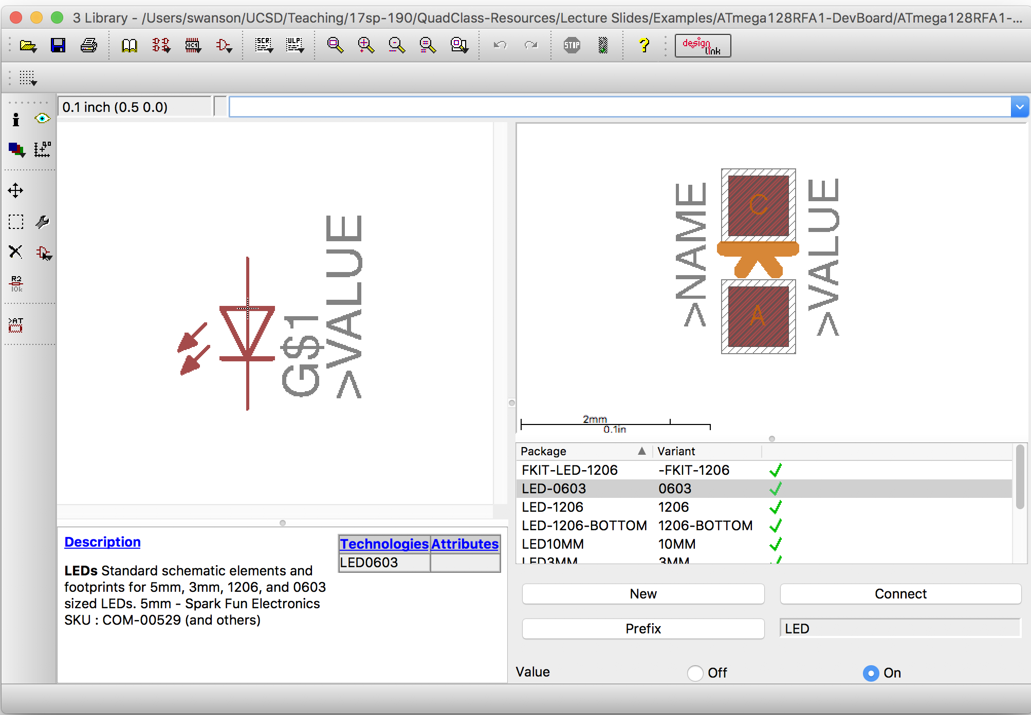
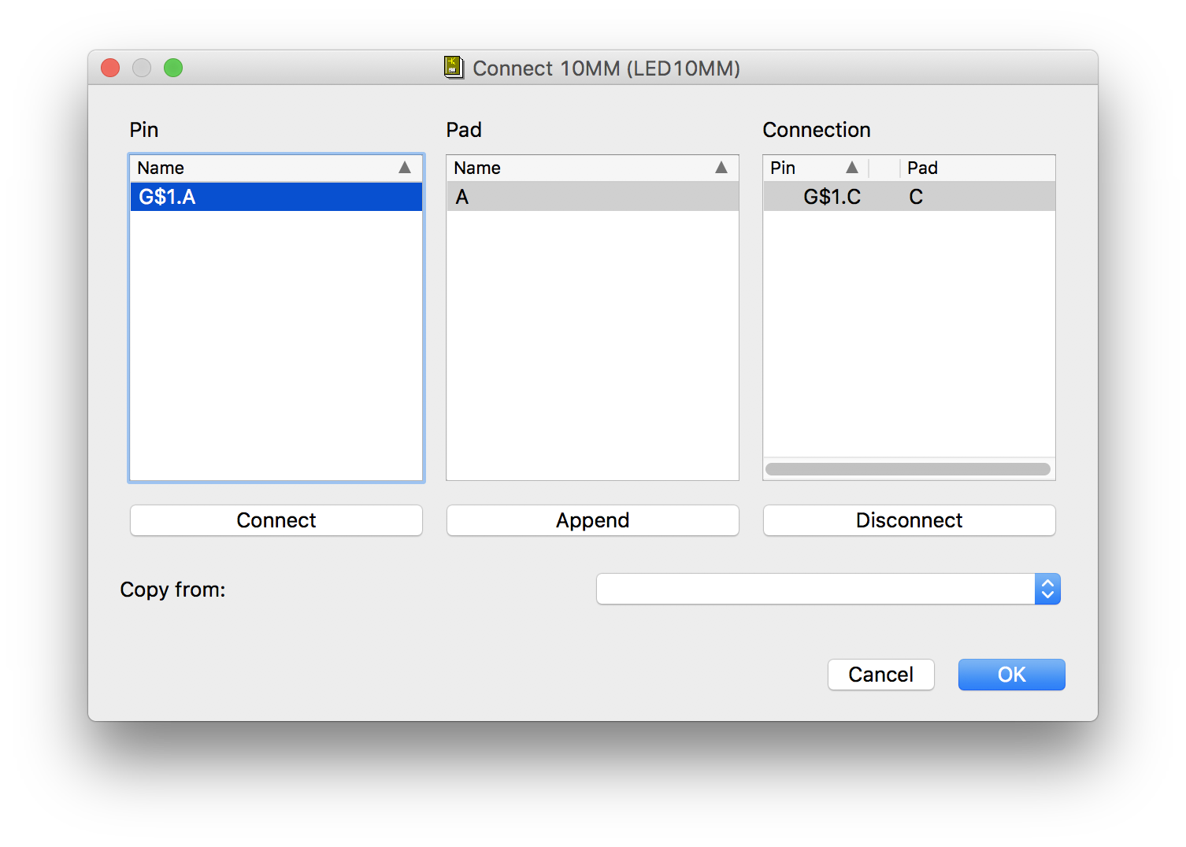
Devices in Eagle

Slide 11
Demo and Lab Walk Through
Datesheets
Mosfet
Symbol
Package – special guidelines
Device
IMU
Symbol
Package
Device

Slide 12
Notes about particular parts

Slide 13
TODO
Add slides for:
Datasheets
SMD vs Through holes
Eagle PAD/SMD terminology.
Flow chart/illustrations of assembly process.
Anatomy of solder joint (showing meniscus)
Side view of board + paste + component.
Problems with IMU pads being in accessible.
Data sheet demo.

